Slide 1


caTissue Suite and CaArray Integration
UAMS Case Study
Umit Topaloglu Ph.D.
University of Arkansas for
Medical Sciences
November 4th, 2009

Slide 2
UAMS: Vision
Implement an interoperable basic and clinical research solution across the enterprise utilizing NCI’s caBIG® and other open source tools
This vision is being championed by the Cancer Institute administration and the Informatics Team
  UAMS is willing to share experiences gained and code developed

Slide 3
UAMS: caBIG Involvement
The Winthrop P. Rockefeller Cancer Institute’s involvement in caBIG®
  Established a caBIG project team
  Evaluated numerous caBIG tools
  Early adopter of caBIG C3D
  First adopter of caXchange and CCTS (C3PR, PSC, Labviewer)
  Developed the portal and SSO LDAP integration
  OpenClinica Integration and caXchange Connector Development
  Switched to caTissue Suite as biospecimen banking solution
  caArray is in use
  caTIES is being used by the Tissue Bank and other researchers

Slide 4
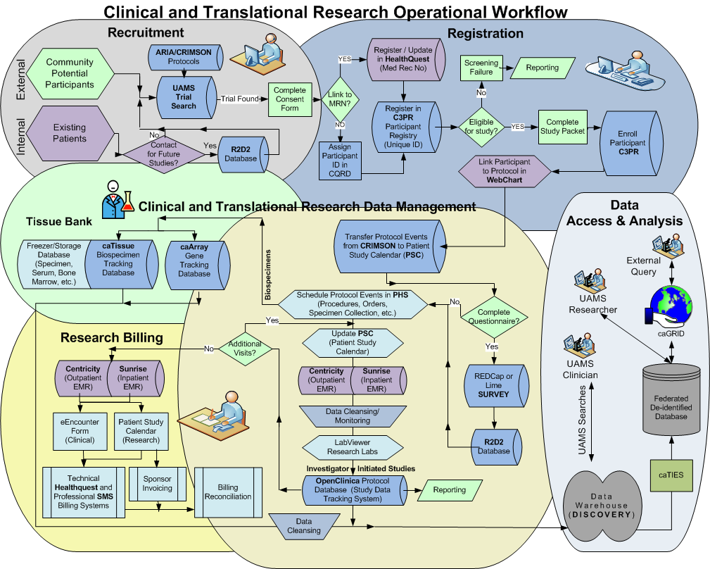
UAMS’ Process Flow
Notes:
Here is an example of our vision of business process that will be implemented using various systems.
Walk thru the diagram.

Slide 5
Steps:
UAMS adoption of caTissue suite and caArray

Slide 6
caTissue suite and caArray
After reviewing functionalities and the workflow, we have decided to customize caTissue suite 1.1, caArray 2.0 :
  caTissue provides:
    robust and useful biospecimen tracking solution
    Dynamic Extensions to house clinical annotations
    Data search and sharing capabilities,
    Open source and community support (KC etc.)
    caBIG standards and compatibility
    Framework that could fit our workflow with some customization
  caArray provides:
    Well managed array data system

Slide 7
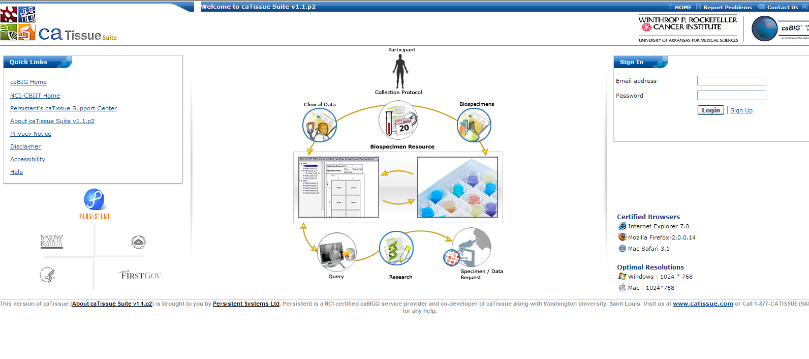
caTissuesuite Login

Slide 8
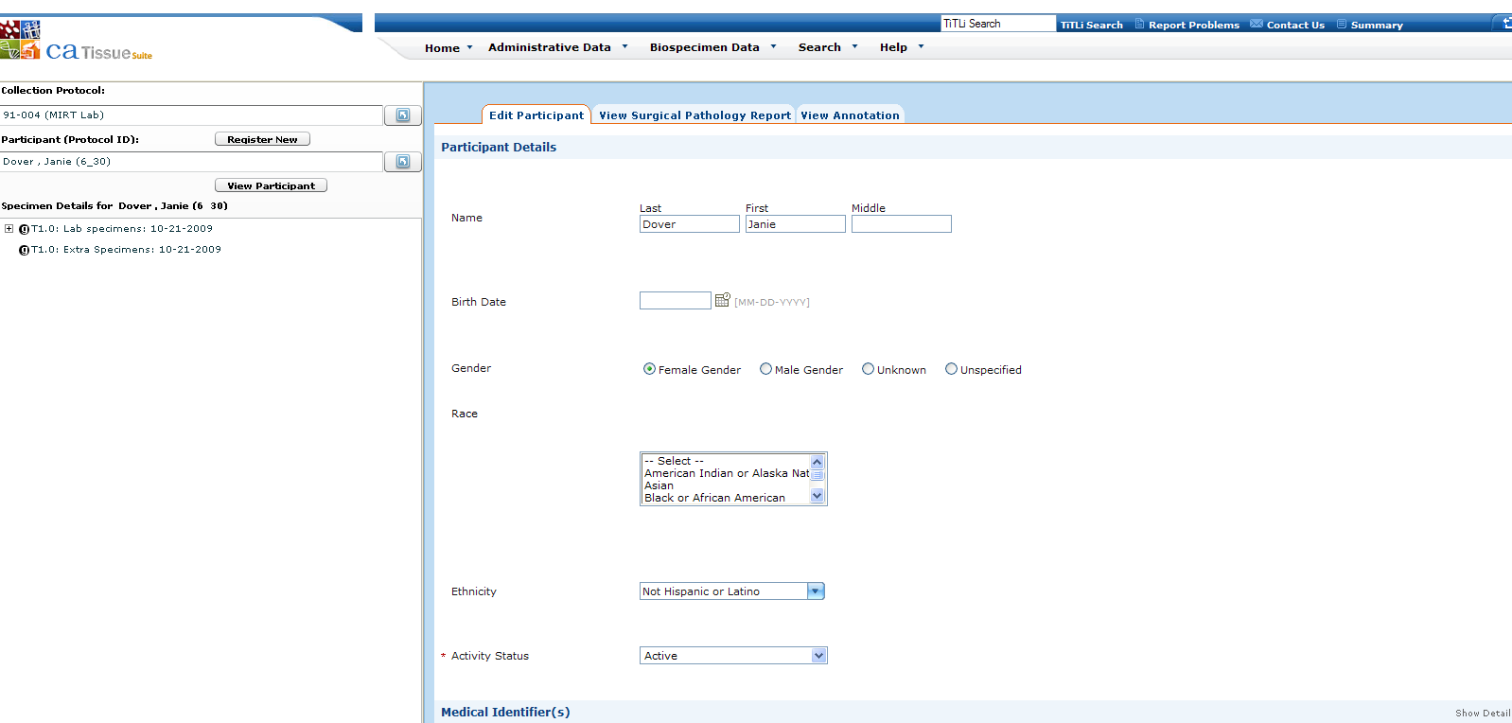
caTissue suite Participant Screen

Slide 9
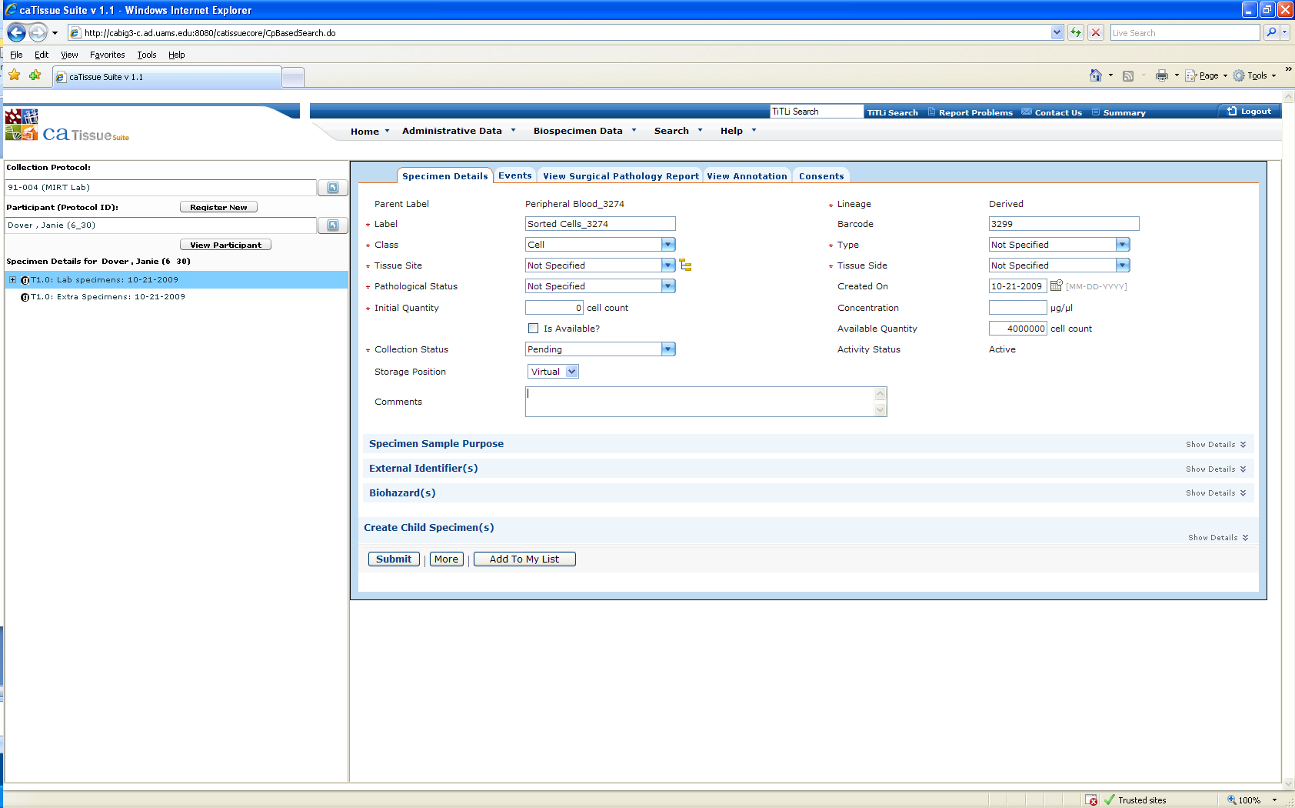
caTissue suite Specimen Entry

Slide 10
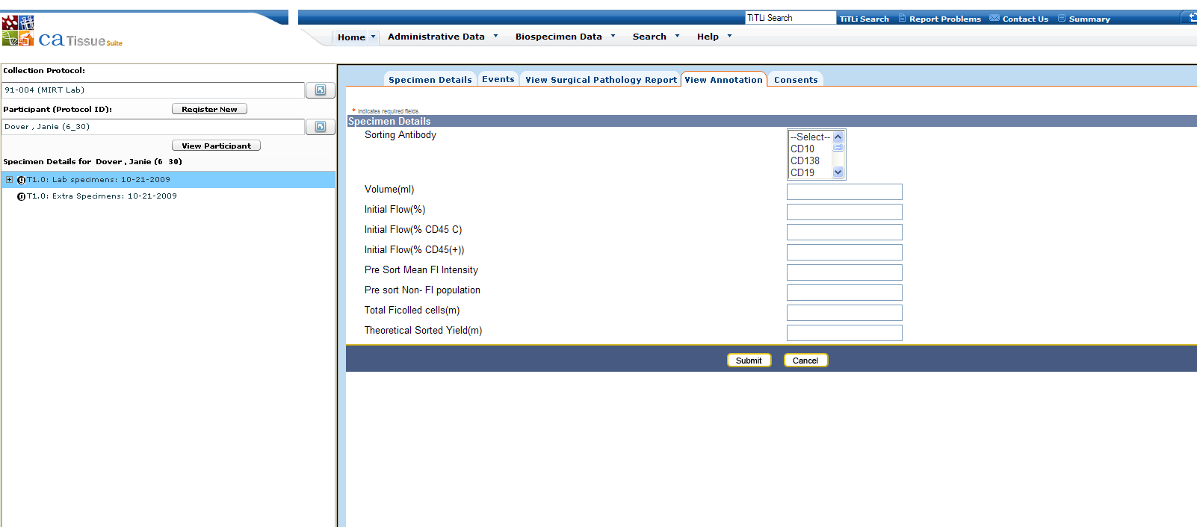
caTissue suite Clinical Annotation

Slide 11
UAMS: Experiment naming
We have developed a complementary web page that interacts with caTissue and caArray.
  For a participant, a specimen may be used for array analysis.
  We want to assign a unique participant ID and experiment number for each Affy run.
  Thus we needed a system to automate the process.
  For each specific specimen being put on a chip, the page pulls the participant id from caTissue and proposes an experiment name.

Slide 12
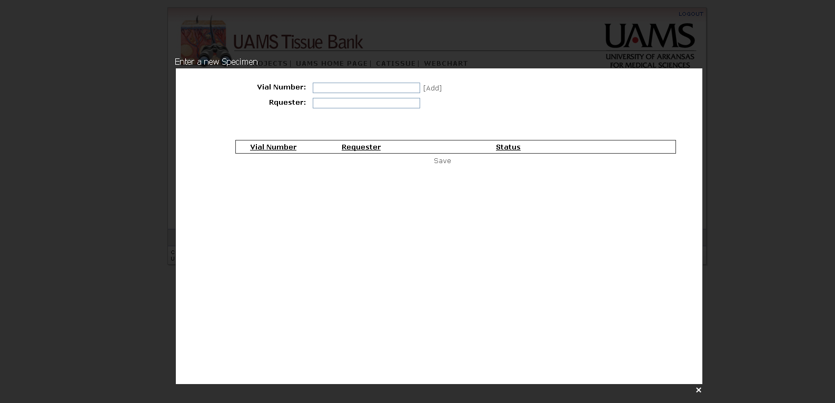
Experiment naming

Slide 13
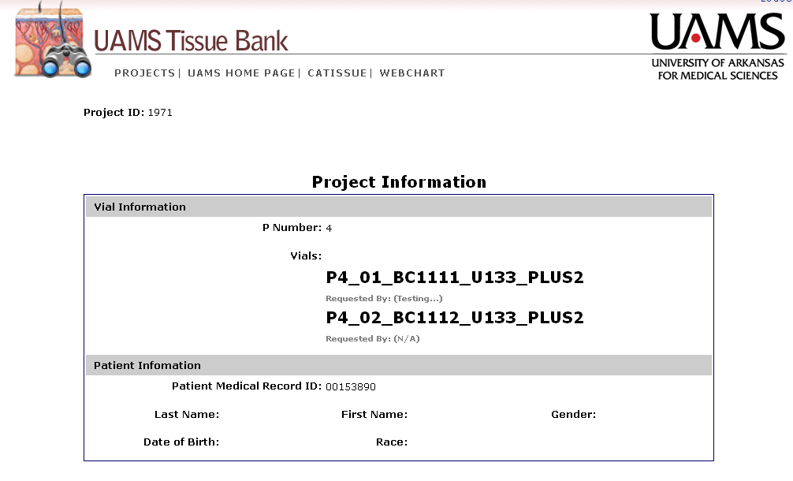
Experiment naming

Slide 14
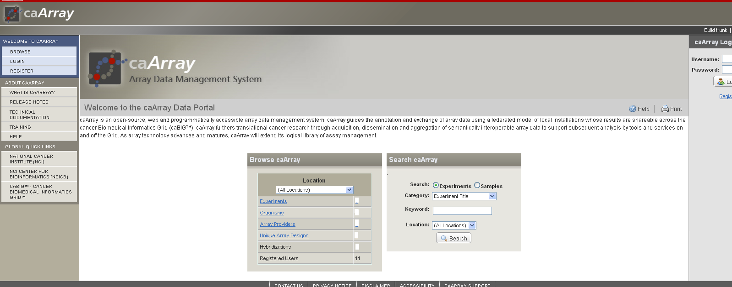
caArray Login

Slide 15
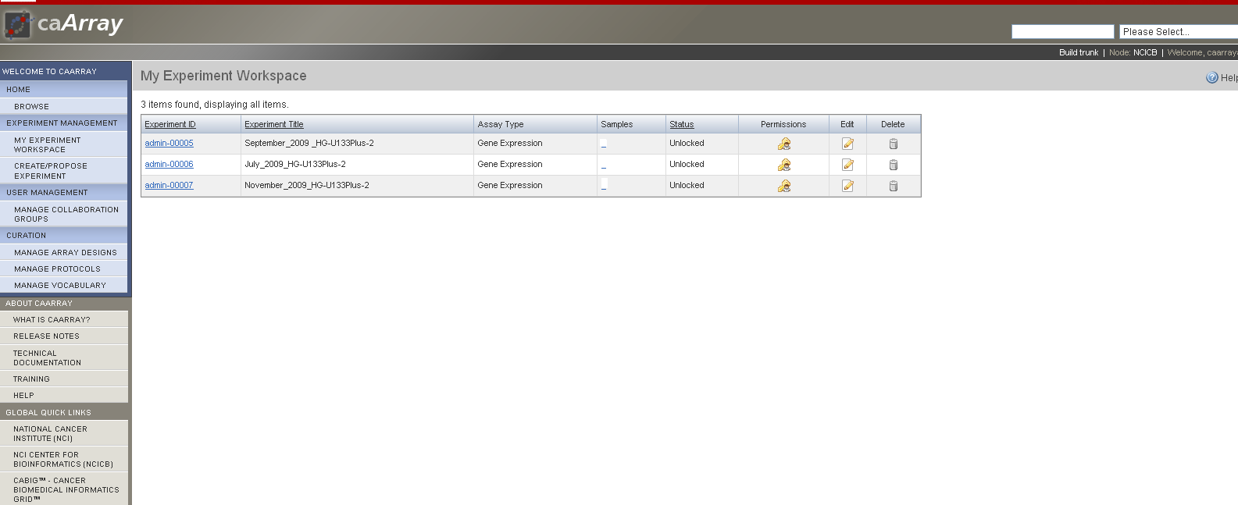
caArray:Experiments

Slide 16
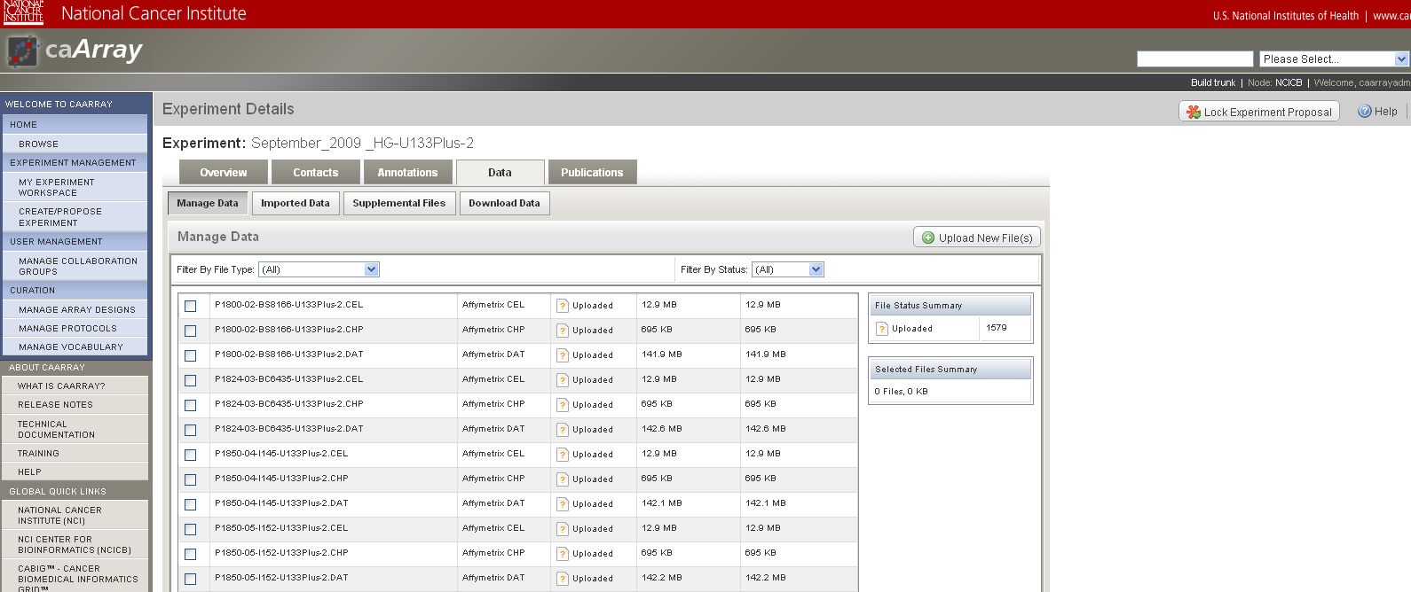
caArray: Experiment files

Slide 17
Workflow Roles
caTissue: Once specimens are processed they are stored in caTissue along with corresponding specimen details. Specimens which are to be given to the array lab are virtually located.
Name generation: Once the array lab gets ready to put the specimen on the chip, it opens the internally developed webpage. They just type in the Patient id and the system automatically generates a identifier to be used to name the corresponding array file types.
Java auto-upload: The files generated are automatically picked up by the java uploader and put into corresponding the experiment in caArray.
Writing files to file system
caArray: In caArray experiments will be created based on each chip type, month and year. The files generated for participant’s specimens are automatically uploaded into caArray. The files are then imported once at every 24 hours.

Slide 18
Resources and Next Steps

Slide 19

Integration via caXchange
caTissue
UAMS
ADT
UAMS Lab
SOFTLAB
UAMS
TrialSearch
Interface
Engine
ARIA
Protocol submission
& approval
C3PR
caXchange
(Integration via grid
and non-grid services)
CRIMSON
Budget
Submission / approval
PSC
Event Tracker
Regulatory Compliance
OpenClinica
caArray
LabViewer
Notes:
Here in Green, we have caBIG® developed applications that UAMS is adapting. OpenClinica integration is developed to provide CCTS interoperability functionality.

Slide 20
Next Steps
Adopting in Myeloma Institute (in progress)
Implement SSO
caXchange interface
Connecting to caGRID as data service
Develop a workflow for the Spit For The Cure specimens

Slide 21
caBIG Team and Collaborators
UAMS IT
  Cheryl Lane – Director
  Umit Topaloglu Ph.D.– Bioinformatics Manager
  Sree Rama Konduri- Developer
  Jiang Bian- Developer
  Calvin Hill – Developer
  Rinku Saha – Bioinformatics Specialist
  Nitin Kanaskar – Developer
UAMS Hematology Oncology
  Laura Hutchins M.D.
UAMS Breast Cancer Research
  Thomas Kieber-Emmons Ph.D.
UAMS Tissue Bank, Pathology
  Marwan Yared M.D.
UAMS Myeloma Institute
  John Shaughnessy, Jr Ph.D.
  Clyde Bailey
  Rachel Flinchum
Persistent
NCI CBIIT

Slide 22
Thanks for listening
Questions?
Contact information:
Umit Topaloglu Ph.D.
utopaloglu@uams.edu
501- 686 - 7238

